Slide 1
CS-773 Project Final Checkpoint Hybrid Cache Architecture for Comprehensive Security
Soumik Dutta, Arnab Bhakta, SM Arif Ali Team Gandiva
23m0826@iitb.ac.in,23m0835@iitb.ac.in,23m0822@iitb.ac.in

Slide 2
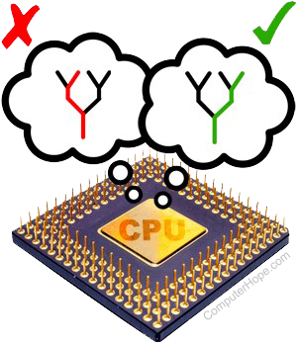
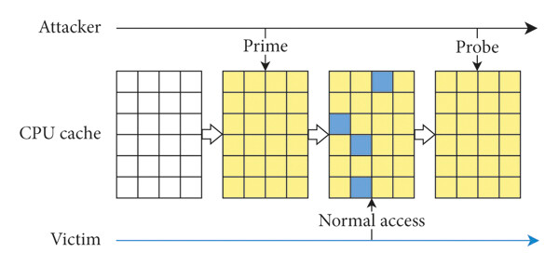


Problem statement
Modern processors are vulnerable to two major classes of attacks
Conflict based attacks
Transient execution attacks
How can we create an unified solution to defend against both attack types keeping performance-security tradeoff in mind?

Slide 3


Prior Works
MIRAGE: Mitigates Conflict-Based Cache Attacks
with a Practical Fully-Associative Design
USENIX Sec ‘21
GhostMinion: A Strictness-Ordered Cache System for Spectre Mitigation
MICRO ‘21
Combining them could provide comprehensive security but requires careful integration

Slide 4
Goal of the Project
Design a hybrid cache architecture that:
01
02
03
Integrates GhostMinion's strictness-order
to prevent transient execution attacks
And evaluate performance overhead of these combined techniques
Combines Mirage's
global eviction to prevent conflict-based attacks
Metrics of interest: IPC, MPKI

Slide 5

Recap of Checkpoint 1

Slide 6
Checkpoint 1: Challenges faced
Version mismatch in gem5 version
Original Mirage in gem5 v19 is not replicable
Ported to latest gem5 v24
Original GhostMinion => gem5 v20
Ported to gem5 v24 but not compatible.
Sol: fallback to gem5 v20
Architecture mismatch
Original Mirage => X86; Original GhostMinion => ARM;
Ported GhostMinion to X86 but not supported;
Finally, Ported Mirage to ARM.
Running benchmark suite
Checkpointing is needed to reproduce results same as given in paper.

Slide 7
Checkpoint 1: Work done
Setup MIRAGE artifact in gem5v24.
Setup GhostMinion artifact in gem5v20.1.
Evaluation of the techniques with 7 SPECspeed®2017Integer & 5 SPECspeed®2017Floating Point benchmarks.

Slide 8
Checkpoint 1: Simulation Configuration
Architecture: ARM-64
Core: Single-Core, 8-Wide, Out-of-order, 2.0GHz
L1D: 32KiB, 2-cycle-latency, 8 way, 4 MSHRs
L1I: 32KiB, 2-cycle-latency, 8 way, 4 MSHRs
L2: 8MiB, 20-cycle-latency, 16 way, 20 MSHRs
DRAM: 8GiB DDR4 2400MT/s
Warmup-Instruction: 500M
Simulation-Instruction: 500M

Slide 9
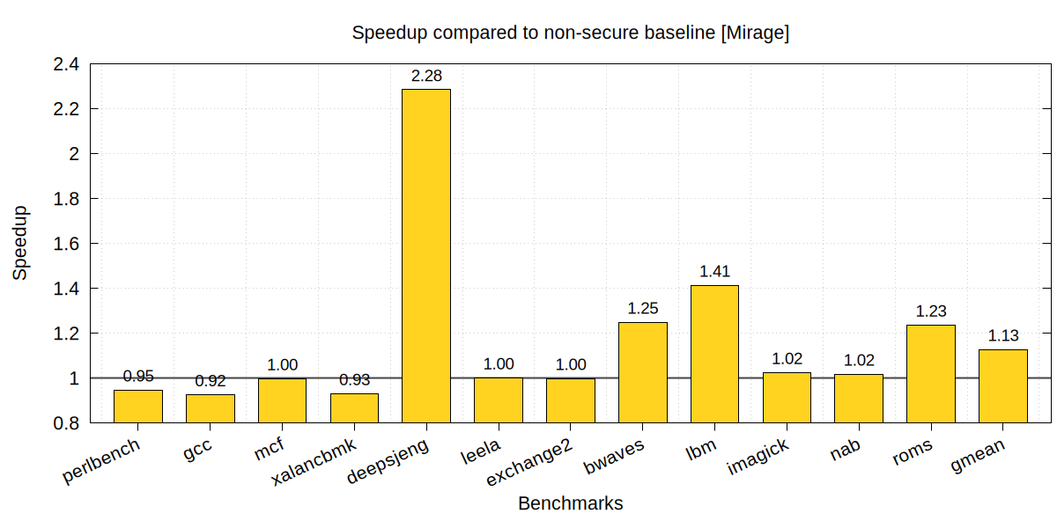
MIRAGE Results - Speedup
Why do we get a speedup in some cases?

Slide 10
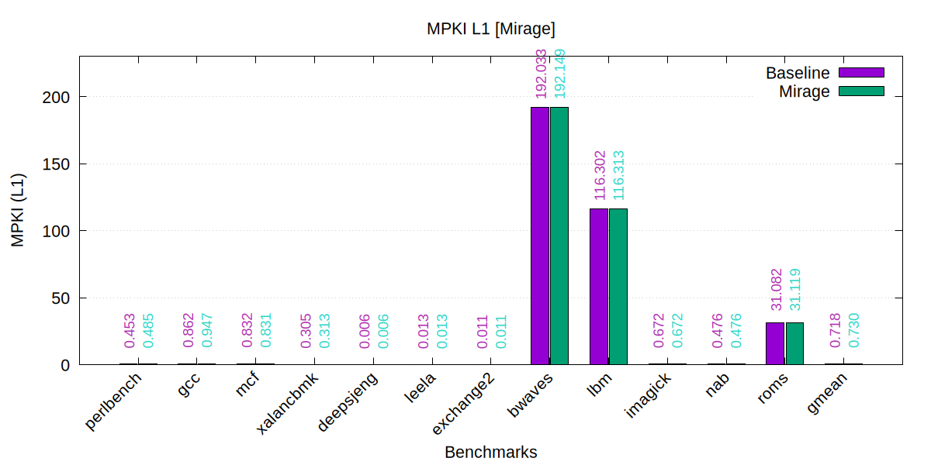
MIRAGE Results - L1 MPKI

Slide 11
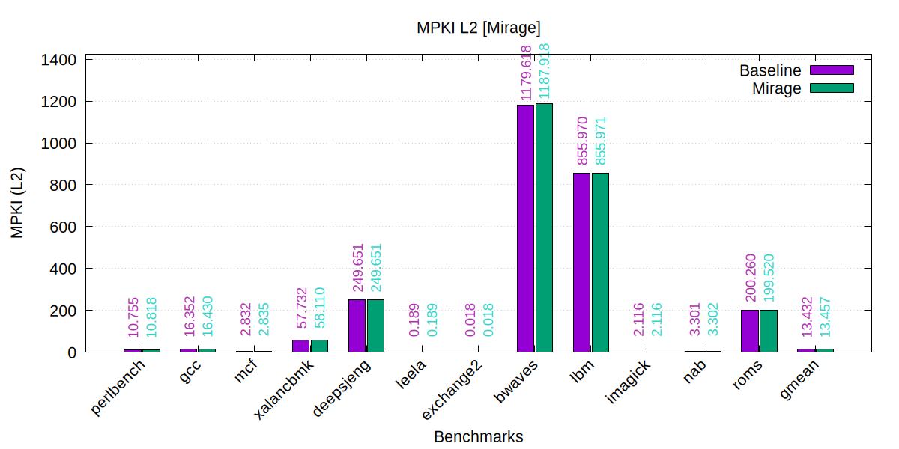
MIRAGE Results - L2 MPKI
MPKI doesn’t explain the performance difference

Slide 12
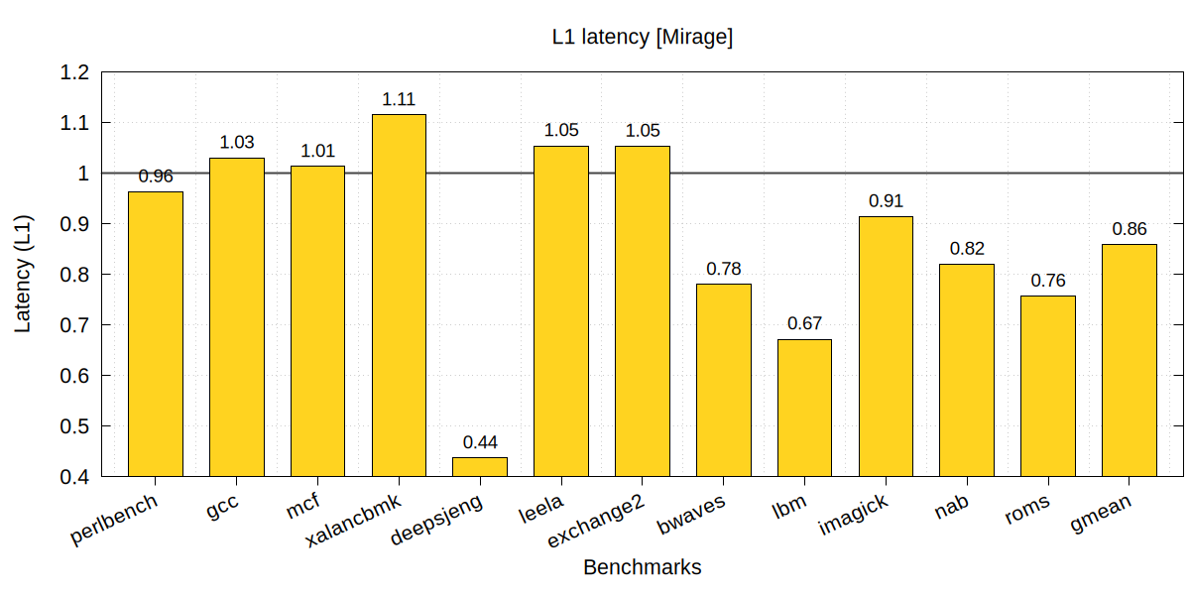
MIRAGE Results - L1 Miss Latency
L1 Miss Latency normalised to baseline
Significant differences in miss latency between baseline and MIRAGE

Slide 13
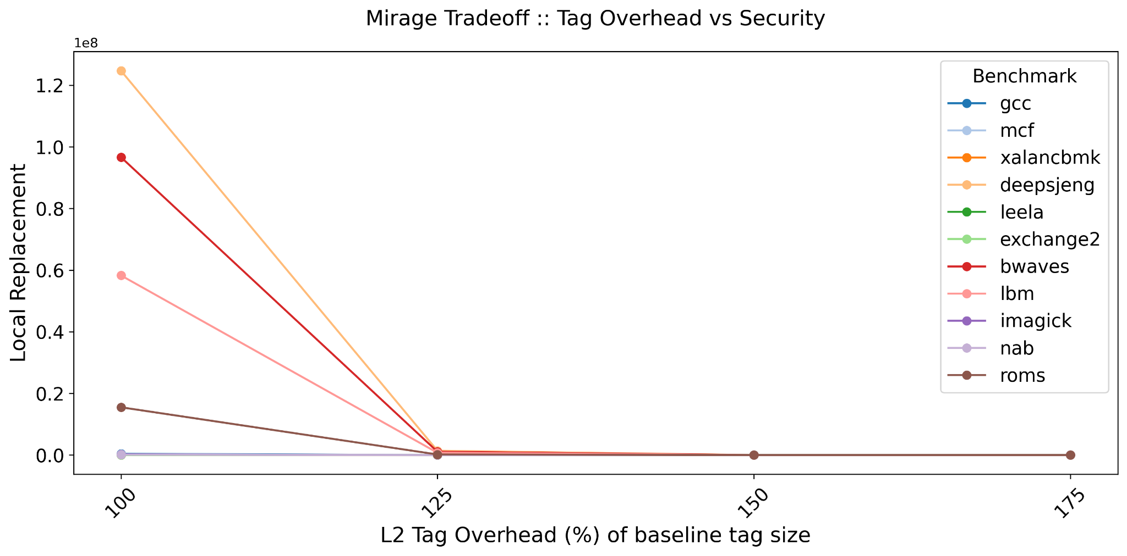
MIRAGE Results - Tradeoff
Set-Associative Eviction decreases as extra tags are used

Slide 14
GhostMinion Configuration
Level: L1-D Cache, L1-I Cache
L2 clusivity: Exclusive
D/I GhostMinions: 2KiB, 2-way, accessed with D/I cache
L2 prefetcher: 8 degree, Stride Prefetcher (64-entry RPT)

Slide 15
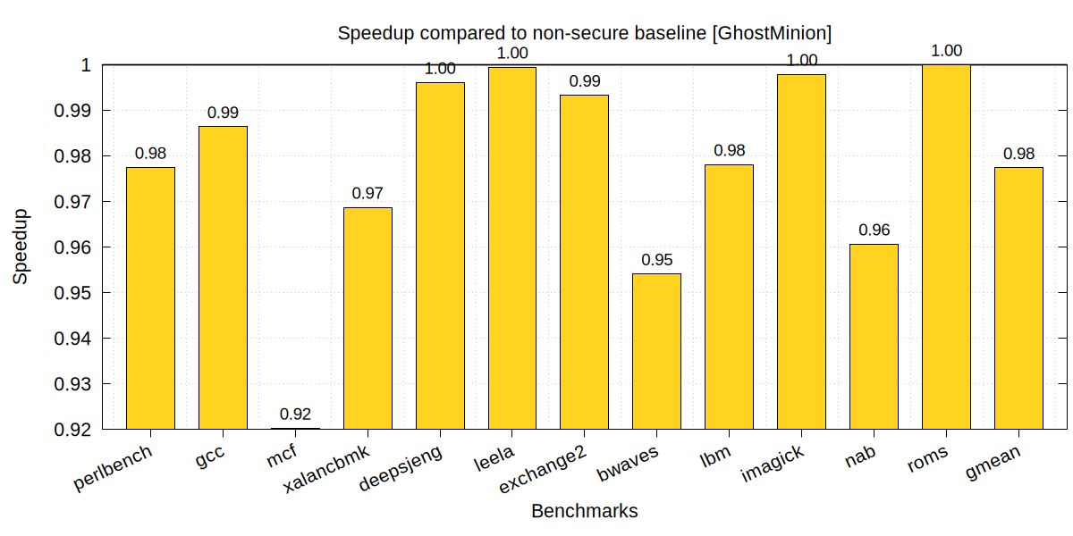
GhostMinion Results - Speedup
Speculative data hiding and strict-ordering causes commit stall

Slide 16
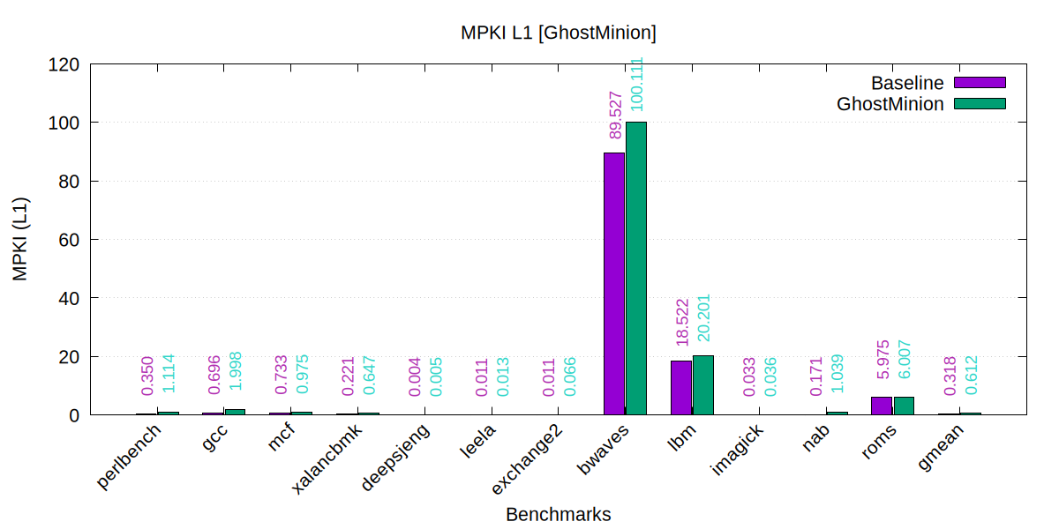
GhostMinion Results - L1 MPKI
Increased MPKI in non-speculative L1 cache

Slide 17
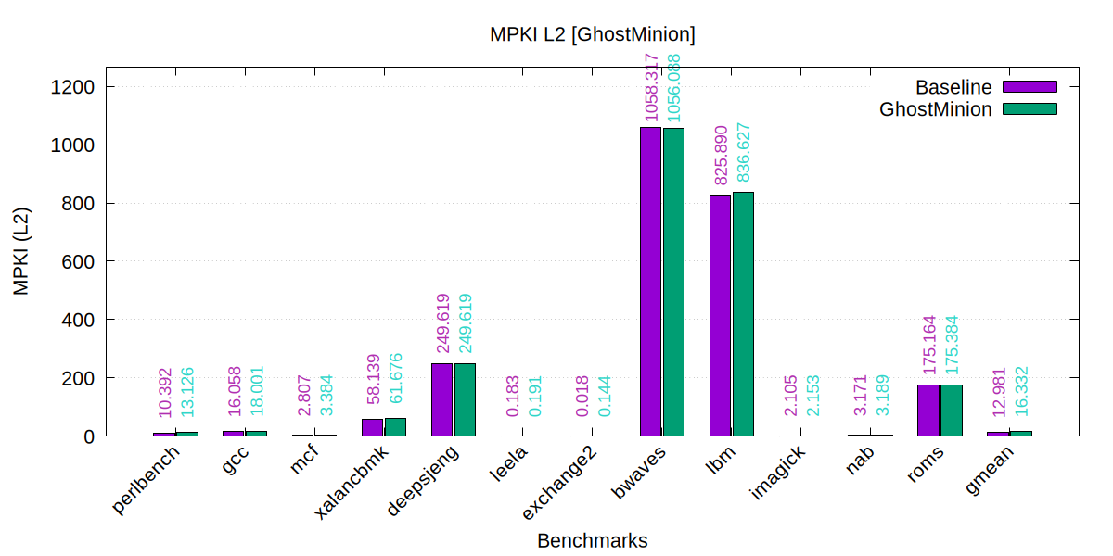
GhostMinion Results - L2 MPKI
No noticeable differences in L2 MPKI for baseline and GhostMinion

Slide 18
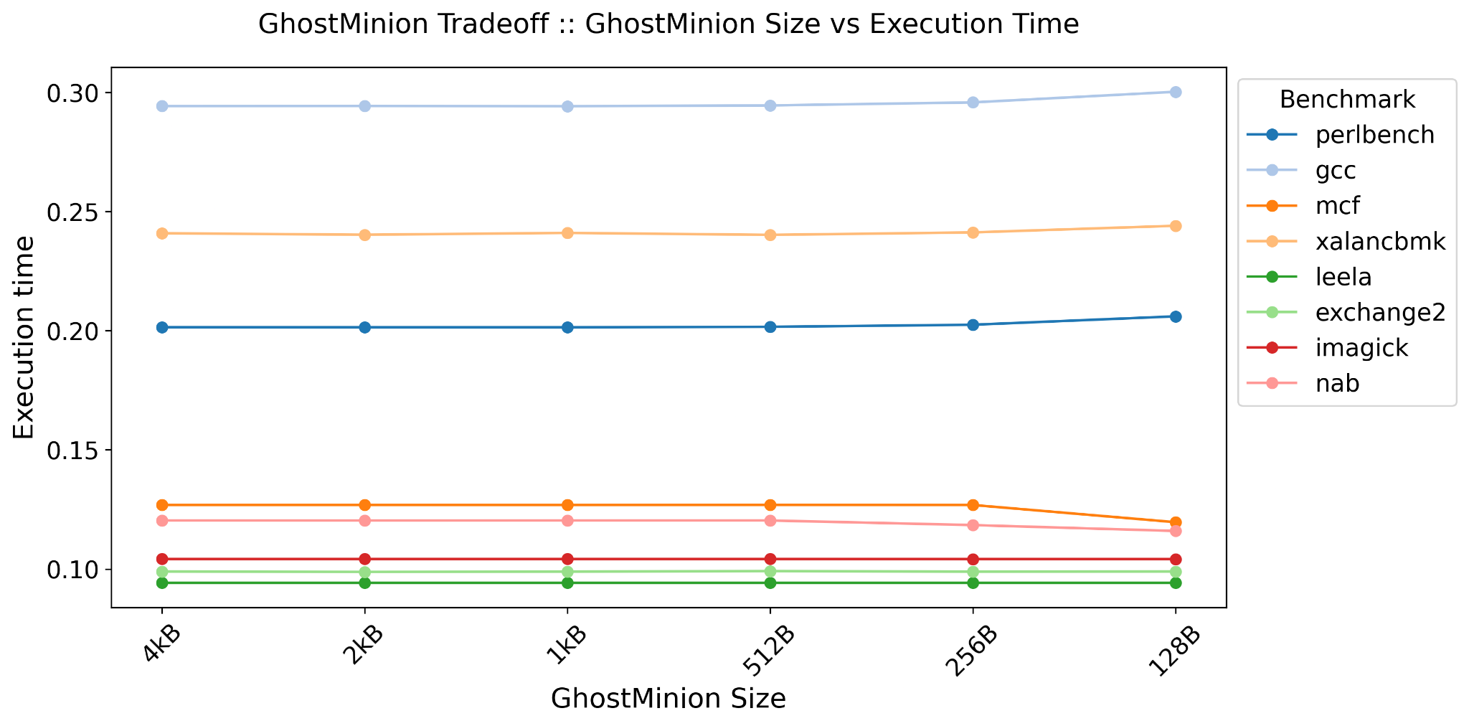
GhostMinion Results: Tradeoff
Insignificant effect on performance on changing GhostMinion size

Slide 19

Entering Checkpoint 2

Slide 20
Action on checkpoint 1 feedback
Feedback Take care of some unexpected results
Action
Took checkpoint at 10B instruction
Re-evaluated benchmarks for larger instruction count from checkpoint

Slide 21
MIRAGE Results Previous - Speedup

Slide 22
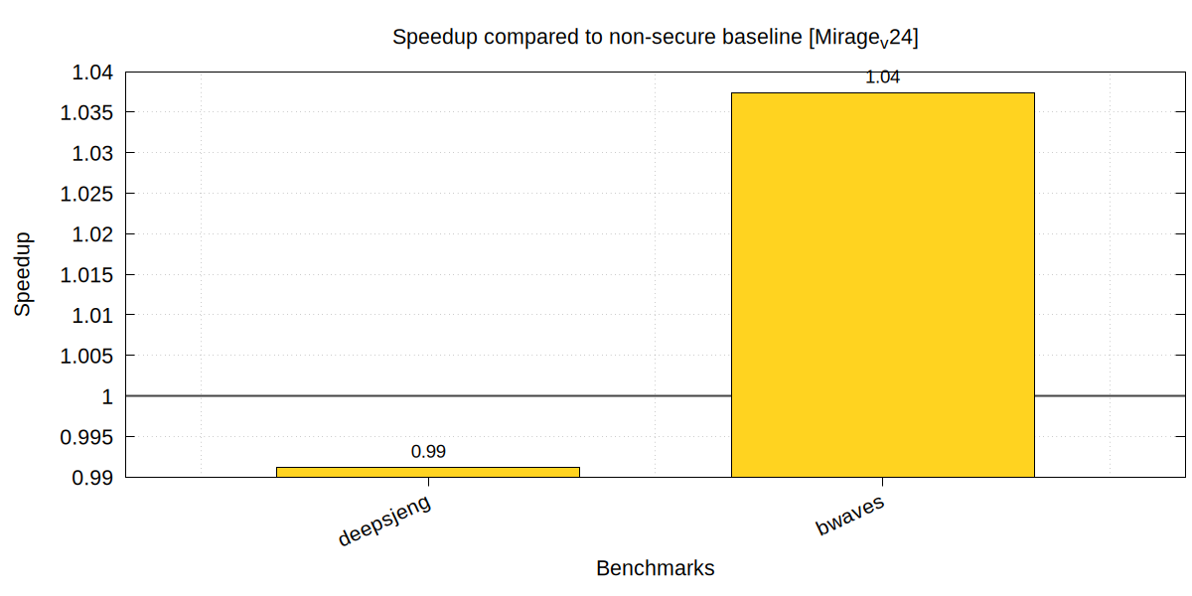
Revised result Revised - Speedup

Slide 23
Work done in checkpoint-II
Integrated MIRAGE & GhostMinion in gem5 v20.1
Implemented checkpointing system to skip first 10B instruction and simulation thereafter.

Slide 24
Configuration in merged technique
DRAM page management policy
GhostMinion: Open adaptive
Mirage: Closed
Combined: Open adaptive
L2 clusivity
GhostMinion: exclusive
Mirage: Inclusive
Combined: Inclusive (exclusive w.r.t ghostminion cache)

Slide 25
Revised Simulation Configuration
Architecture: ARM-64
Core: Single-Core, 8-Wide, Out-of-order, 2.0GHz
L1D: 32KiB, 2-cycle-latency, 8 way, 4 MSHRs
L1I: 32KiB, 2-cycle-latency, 8 way, 4 MSHRs
L2: 8MiB, 20-cycle-latency, 16 way, 20 MSHRs
DRAM: 16GiB DDR4 2400MT/s
Warmup-Instruction: 500M
Simulation-Instruction: 2B*
*initially tried with 10B instructions but each benchmark took about 45hrs

Slide 26
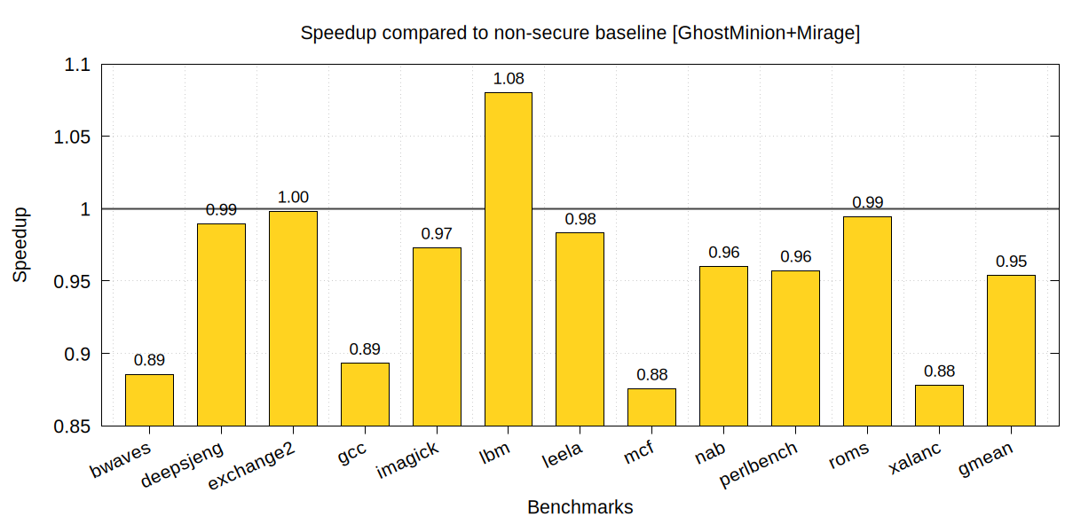
Results: Speedup
The combined technique exhibit a 5% slowdown on average

Slide 27
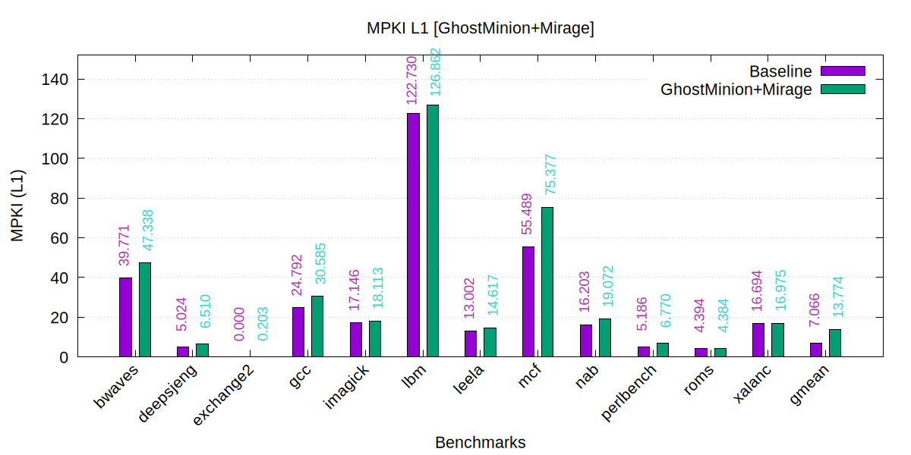
Results - L1 MPKI
High L1 MPKI but no effect on IPC. Why?
bwaves, gcc, mcf, xalanc suffers high MPKI at both L1 and L2

Slide 28
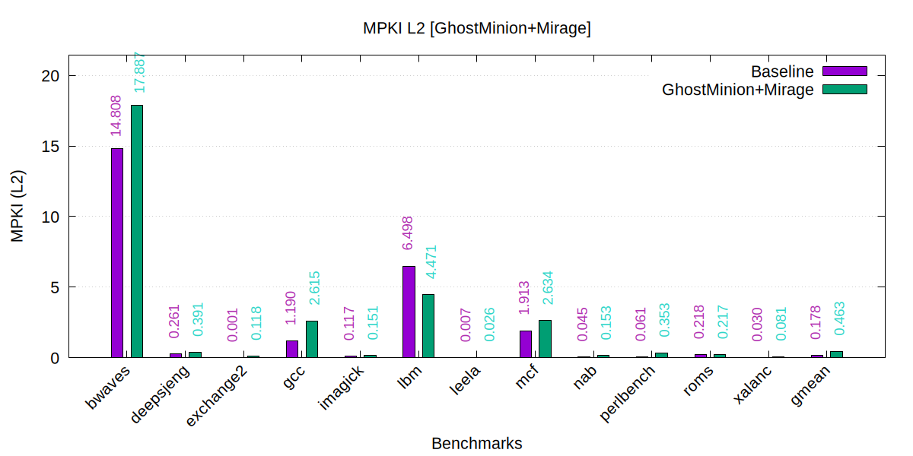
Results - L2 MPKI
Slight speedup in lbm due to L2 MPKI lower than baseline

Slide 29
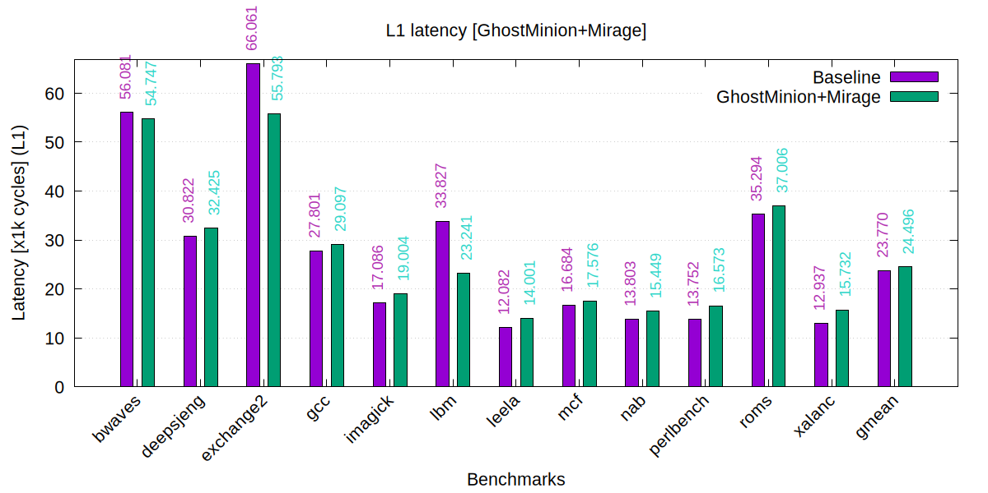
Results - L1 Miss Latency
Both lbm and exchange2 encounter significantly lower miss latency

Slide 30
Github link
https://github.com/sammagnet7/cs773_CompArch-Perf-Security

Slide 31
Final Checkpoint Video
https://www.youtube.com/watch?v=lM6voFCyAXU

Slide 32
MIRAGE Configuration
Level: L2
L2 clusivity: Inclusive
L2 Skews: 2
Tag to Data Ratio: 1.75 (75% extra tags)
Encryption Latency: 2 cycles

